Slide 1
R-programming
http://www.r-project.org/
http://cran.r-project.org/
Hung Chen

Slide 2
Outline
Introduction:
  Historical development
  S, Splus
  Capability
  Statistical Analysis
References
Calculator
Data Type
Resources
Simulation and Statistical Tables
  Probability distributions
Programming
  Grouping, loops and conditional execution
  Function
Reading and writing data from files
Modeling
  Regression
  ANOVA
Data Analysis on Association
  Lottery
  Geyser
Smoothing

Slide 3
R, S and S-plus
S: an interactive environment for data analysis developed at Bell Laboratories since 1976
  1988 - S2: RA Becker, JM Chambers, A Wilks
  1992 - S3: JM Chambers, TJ Hastie
  1998 - S4: JM Chambers
Exclusively licensed by AT&T/Lucent to Insightful Corporation, Seattle WA. Product name: “S-plus”.
Implementation languages C, Fortran.
See:
http://cm.bell-labs.com/cm/ms/departments/sia/S/history.html
R: initially written by Ross Ihaka and Robert Gentleman at Dep. of Statistics of U of Auckland, New Zealand during 1990s.
Since 1997: international “R-core” team of ca. 15 people with access to common CVS archive.

Slide 4
Introduction
R is “GNU S” — A language and environment for data manipula-tion, calculation and graphical display.
  R is similar to the award-winning S system, which was developed at Bell Laboratories by John Chambers et al.
  a suite of operators for calculations on arrays, in particular matrices,
  a large, coherent, integrated collection of intermediate tools for interactive data analysis,
  graphical facilities for data analysis and display either directly at the computer or on hardcopy
  a well developed programming language which includes conditionals, loops, user defined recursive functions and input and output facilities.
The core of R is an interpreted computer language.
  It allows branching and looping as well as modular programming using functions.
  Most of the user-visible functions in R are written in R, calling upon a smaller set of internal primitives.
  It is possible for the user to interface to procedures written in C, C++ or FORTRAN languages for efficiency, and also to write additional primitives.

Slide 5
What R does and does not
data handling and storage: numeric, textual
matrix algebra
hash tables and regular expressions
high-level data analytic and statistical functions
classes (“OO”)
graphics
programming language: loops, branching, subroutines
is not a database, but connects to DBMSs
has no graphical user interfaces, but connects to Java, TclTk
language interpreter can be very slow, but allows to call own C/C++ code
no spreadsheet view of data, but connects to Excel/MsOffice
no professional / commercial support

Slide 6
R and statistics
Packaging: a crucial infrastructure to efficiently produce, load and keep consistent software libraries from (many) different sources / authors
Statistics: most packages deal with statistics and data analysis
State of the art: many statistical researchers provide their methods as R packages

Slide 7
Data Analysis and Presentation
The R distribution contains functionality for large number of statistical procedures.
  linear and generalized linear models
  nonlinear regression models
  time series analysis
  classical parametric and nonparametric tests
  clustering
  smoothing
R also has a large set of functions which provide a flexible graphical environment for creating various kinds of data presentations.

Slide 8
References
For R,
  The basic reference is The New S Language: A Programming Environment for Data Analysis and Graphics by Richard A. Becker, John M. Chambers and Allan R. Wilks (the “Blue Book”) .
  The new features of the 1991 release of S (S version 3) are covered in Statistical Models in S edited by John M. Chambers and Trevor J. Hastie (the “White Book”).
  Classical and modern statistical techniques have been implemented.
    Some of these are built into the base R environment.
    Many are supplied as packages. There are about 8 packages supplied with R (called “standard” packages) and many more are available through the cran family of Internet sites (via http://cran.r-project.org).
All the R functions have been documented in the form of help pages in an “output independent” form which can be used to create versions for HTML, LATEX, text etc.
  The document “An Introduction to R” provides a more user-friendly starting point.
  An “R Language Definition” manual
  More specialized manuals on data import/export and extending R.

Slide 9
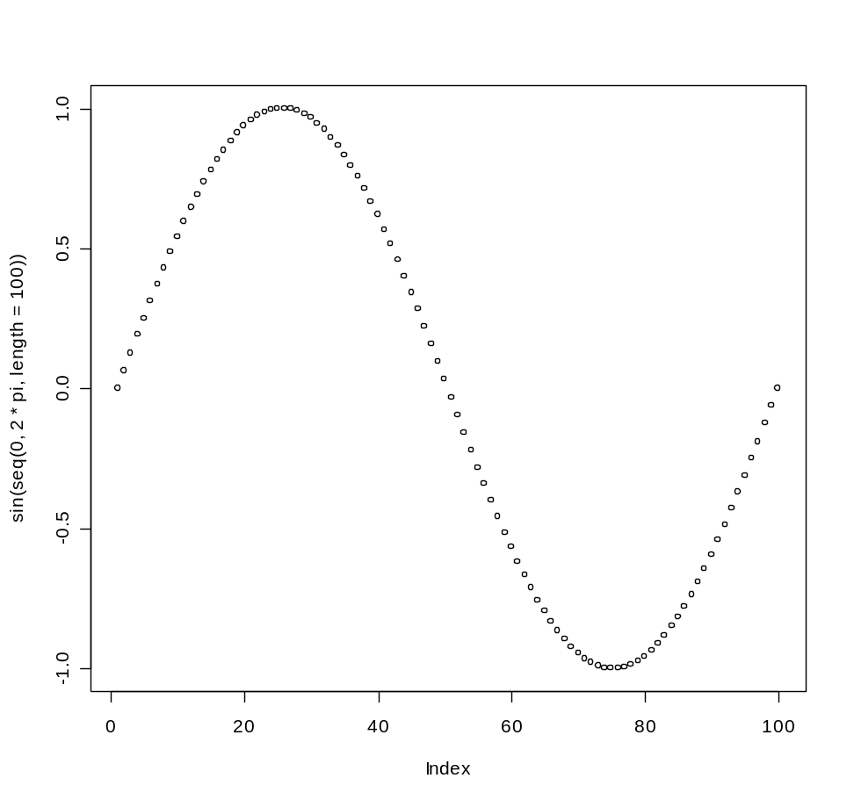
R as a calculator
> log2(32)
[1] 5
> sqrt(2)
[1] 1.414214
> seq(0, 5, length=6)
[1] 0 1 2 3 4 5
> plot(sin(seq(0, 2*pi, length=100)))

Slide 10
Object orientation
primitive (or: atomic) data types in R are:
numeric (integer, double, complex)
character
logical
function
out of these, vectors, arrays, lists can be built.

Slide 11
Object orientation
Object: a collection of atomic variables and/or other objects that belong together
Example: a microarray experiment
  probe intensities
  patient data (tissue location, diagnosis, follow-up)
  gene data (sequence, IDs, annotation)
Parlance:
class: the “abstract” definition of it
object: a concrete instance
method: other word for ‘function’
slot: a component of an object

Slide 12
Object orientation
Advantages:
Encapsulation (can use the objects and methods someone else has written without having to care about the internals)
Generic functions (e.g. plot, print)
Inheritance (hierarchical organization of complexity)
Caveat:
Overcomplicated, baroque program architecture…

Slide 13
variables
> a = 49
> sqrt(a)
[1] 7
> a = "The dog ate my homework"
> sub("dog","cat",a)
[1] "The cat ate my homework“
> a = (1+1==3)
> a
[1] FALSE
numeric
character string
logical

Slide 14
vectors, matrices and arrays
vector: an ordered collection of data of the same type
> a = c(1,2,3)
> a*2
[1] 2 4 6
Example: the mean spot intensities of all 15488 spots on a chip: a vector of 15488 numbers
In R, a single number is the special case of a vector with 1 element.
Other vector types: character strings, logical

Slide 15
vectors, matrices and arrays
matrix: a rectangular table of data of the same type
example: the expression values for 10000 genes for 30 tissue biopsies: a matrix with 10000 rows and 30 columns.
array: 3-,4-,..dimensional matrix
example: the red and green foreground and background values for 20000 spots on 120 chips: a 4 x 20000 x 120 (3D) array.

Slide 16
Lists
vector: an ordered collection of data of the same type.
> a = c(7,5,1)
> a[2]
[1] 5
list: an ordered collection of data of arbitrary types.
> doe = list(name="john",age=28,married=F)
> doe$name
[1] "john“
> doe$age
[1] 28
Typically, vector elements are accessed by their index (an integer), list elements by their name (a character string). But both types support both access methods.

Slide 17
Data frames
data frame: is supposed to represent the typical data table that researchers come up with – like a spreadsheet.
It is a rectangular table with rows and columns; data within each column has the same type (e.g. number, text, logical), but different columns may have different types.
Example:
> a
localisation tumorsize progress
XX348 proximal 6.3 FALSE
XX234 distal 8.0 TRUE
XX987 proximal 10.0 FALSE

Slide 18
Factors
A character string can contain arbitrary text. Sometimes it is useful to use a limited vocabulary, with a small number of allowed words. A factor is a variable that can only take such a limited number of values, which are called levels.
> a
[1] Kolon(Rektum) Magen Magen
[4] Magen Magen Retroperitoneal
[7] Magen Magen(retrogastral) Magen
Levels: Kolon(Rektum) Magen Magen(retrogastral) Retroperitoneal
> class(a)
[1] "factor"
> as.character(a)
[1] "Kolon(Rektum)" "Magen" "Magen"
[4] "Magen" "Magen" "Retroperitoneal"
[7] "Magen" "Magen(retrogastral)" "Magen"
> as.integer(a)
[1] 1 2 2 2 2 4 2 3 2
> as.integer(as.character(a))
[1] NA NA NA NA NA NA NA NA NA NA NA NA
Warning message: NAs introduced by coercion

Slide 19
Subsetting
Individual elements of a vector, matrix, array or data frame are accessed with “[ ]” by specifying their index, or their name
> a
localisation tumorsize progress
XX348 proximal 6.3 0
XX234 distal 8.0 1
XX987 proximal 10.0 0
> a[3, 2]
[1] 10
> a["XX987", "tumorsize"]
[1] 10
> a["XX987",]
localisation tumorsize progress
XX987 proximal 10 0

Slide 20
Subsetting
> a
localisation tumorsize progress
XX348 proximal 6.3 0
XX234 distal 8.0 1
XX987 proximal 10.0 0
> a[c(1,3),]
localisation tumorsize progress
XX348 proximal 6.3 0
XX987 proximal 10.0 0
> a[c(T,F,T),]
localisation tumorsize progress
XX348 proximal 6.3 0
XX987 proximal 10.0 0
> a$localisation
[1] "proximal" "distal" "proximal"
> a$localisation=="proximal"
[1] TRUE FALSE TRUE
> a[ a$localisation=="proximal", ]
localisation tumorsize progress
XX348 proximal 6.3 0
XX987 proximal 10.0 0
subset rows by a vector of indices
subset rows by a logical vector
subset a column
comparison resulting in logical vector
subset the selected rows

Slide 21
Resources
A package specification allows the production of loadable modules for specific purposes, and several contributed packages are made available through the CRAN sites.
CRAN and R homepage:
  http://www.r-project.org/
  It is R’s central homepage, giving information on the R project and everything related to it.
  http://cran.r-project.org/
  It acts as the download area,carrying the software itself, extension packages, PDF manuals.
Getting help with functions and features
  help(solve)
  ?solve
  For a feature specified by special characters, the argument must be enclosed in double or single quotes, making it a “character string”: help("[[")

Slide 22
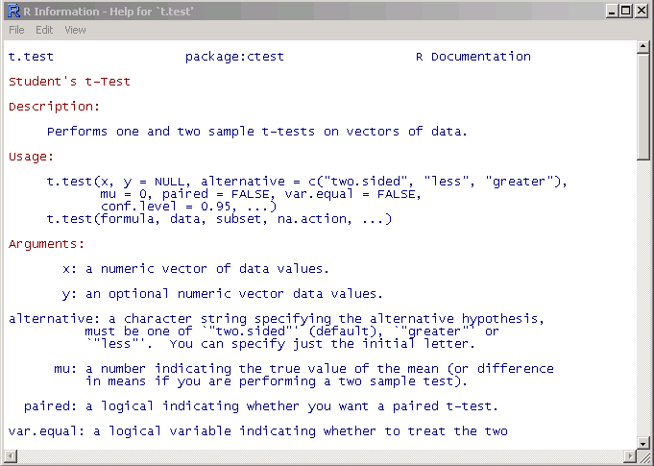
Getting help
Details about a specific command whose name you know (input arguments, options, algorithm, results):
>? t.test
or
>help(t.test)

Slide 23
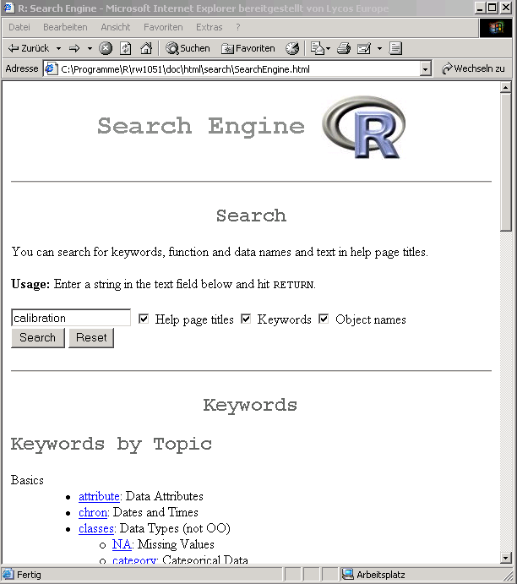
Getting help o HTML search engine o Search for topics with regular expressions:
“help.search”

Slide 24
Probability distributions
Cumulative distribution function P(X ≤ x): ‘p’ for the CDF
Probability density function: ‘d’ for the density,,
Quantile function (given q, the smallest x such that P(X ≤ x) > q): ‘q’ for the quantile
simulate from the distribution: ‘r
Distribution R name additional arguments
beta beta shape1, shape2, ncp
binomial binom size, prob
Cauchy cauchy location, scale
chi-squared chisq df, ncp
exponential exp rate
F f df1, df1, ncp
gamma gamma shape, scale
geometric geom prob
hypergeometric hyper m, n, k
log-normal lnorm meanlog, sdlog
logistic logis; negative binomial nbinom; normal norm; Poisson pois; Student’s t t ; uniform unif; Weibull weibull; Wilcoxon wilcox

Slide 25
Grouping, loops and conditional execution
Grouped expressions
  R is an expression language in the sense that its only command type is a function or expression which returns a result.
  Commands may be grouped together in braces, {expr 1, . . ., expr m}, in which case the value of the group is the result of the last expression in the group evaluated.
Control statements
  if statements
  The language has available a conditional construction of the form
  if (expr 1) expr 2 else expr 3
  where expr 1 must evaluate to a logical value and the result of the entire expression is then evident.
  a vectorized version of the if/else construct, the ifelse function. This has the form ifelse(condition, a, b)

Slide 26
Repetitive execution
for loops, repeat and while
  for (name in expr 1) expr 2
  where name is the loop variable. expr 1 is a vector expression, (often a sequence like 1:20), and expr 2 is often a grouped expression with its sub-expressions written in terms of the dummy name. expr 2 is repeatedly evaluated as name ranges through the values in the vector result of expr 1.
Other looping facilities include the
  repeat expr statement and the
  while (condition) expr statement.
  The break statement can be used to terminate any loop, possibly abnormally. This is the only way to terminate repeat loops.
  The next statement can be used to discontinue one particular cycle and skip to the “next”.

Slide 27
Branching
if (logical expression) {
statements
} else {
alternative statements
}
else branch is optional

Slide 28
Loops
When the same or similar tasks need to be performed multiple times; for all elements of a list; for all columns of an array; etc.
  Monte Carlo Simulation
  Cross-Validation (delete one and etc)
for(i in 1:10) {
print(i*i)
}
i=1
while(i<=10) {
print(i*i)
i=i+sqrt(i)
}

Slide 29
lapply, sapply, apply
When the same or similar tasks need to be performed multiple times for all elements of a list or for all columns of an array.
  May be easier and faster than “for” loops
lapply(li, function )
  To each element of the list li, the function function is applied.
  The result is a list whose elements are the individual function results.
> li = list("klaus","martin","georg")
> lapply(li, toupper)
> [[1]]
> [1] "KLAUS"
> [[2]]
> [1] "MARTIN"
> [[3]]
> [1] "GEORG"

Slide 30
lapply, sapply, apply
sapply( li, fct )
Like apply, but tries to simplify the result, by converting it into a vector or array of appropriate size
> li = list("klaus","martin","georg")
> sapply(li, toupper)
[1] "KLAUS" "MARTIN" "GEORG"
> fct = function(x) { return(c(x, x*x, x*x*x)) }
> sapply(1:5, fct)
[,1] [,2] [,3] [,4] [,5]
[1,] 1 2 3 4 5
[2,] 1 4 9 16 25
[3,] 1 8 27 64 125

Slide 31
apply
apply( arr, margin, fct )
Apply the function fct along some dimensions of the array arr, according to margin, and return a vector or array of the appropriate size.
> x
[,1] [,2] [,3]
[1,] 5 7 0
[2,] 7 9 8
[3,] 4 6 7
[4,] 6 3 5
> apply(x, 1, sum)
[1] 12 24 17 14
> apply(x, 2, sum)
[1] 22 25 20

Slide 32
functions and operators
Functions do things with data
“Input”: function arguments (0,1,2,…)
“Output”: function result (exactly one)
Example:
add = function(a,b)
{ result = a+b
return(result) }
Operators:
Short-cut writing for frequently used functions of one or two arguments.
Examples: + - * / ! & | %%

Slide 33
functions and operators
Functions do things with data
  “Input”: function arguments (0,1,2,…)
  “Output”: function result (exactly one)
Exceptions to the rule:
Functions may also use data that sits around in other places, not just in their argument list: “scoping rules”*
Functions may also do other things than returning a result. E.g., plot something on the screen: “side effects”
* Lexical scope and Statistical Computing.
R. Gentleman, R. Ihaka, Journal of Computational and Graphical Statistics, 9(3), p. 491-508 (2000).

Slide 34
Reading data from files
The read.table() function
  To read an entire data frame directly, the external file will normally have a special form.
  The first line of the file should have a name for each variable in the data frame.
  Each additional line of the file has its first item a row label and the values for each variable.
  Price Floor Area Rooms Age Cent.heat
  01 52.00 111.0 830 5 6.2 no
  02 54.75 128.0 710 5 7.5 no
  03 57.50 101.0 1000 5 4.2 no
  04 57.50 131.0 690 6 8.8 no
  05 59.75 93.0 900 5 1.9 yes
  ...
numeric variables and nonnumeric variables (factors)

Slide 35
Reading data from files
HousePrice <- read.table("houses.data", header=TRUE)
Price Floor Area Rooms Age Cent.heat
52.00 111.0 830 5 6.2 no
54.75 128.0 710 5 7.5 no
57.50 101.0 1000 5 4.2 no
57.50 131.0 690 6 8.8 no
59.75 93.0 900 5 1.9 yes
  ...
The data file is named ‘input.dat’.
  Suppose the data vectors are of equal length and are to be read in in parallel.
  Suppose that there are three vectors, the first of mode character and the remaining two of mode numeric.
The scan() function
  inp<- scan("input.dat", list("",0,0))
  To separate the data items into three separate vectors, use assignments like
label <- inp[[1]]; x <- inp[[2]]; y <- inp[[3]]
  inp <- scan("input.dat", list(id="", x=0, y=0)); inp$id; inp$x; inp$y

Slide 36
Storing data
Every R object can be stored into and restored from a file with the commands “save” and “load”.
This uses the XDR (external data representation) standard of Sun Microsystems and others, and is portable between MS-Windows, Unix, Mac.
> save(x, file=“x.Rdata”)
> load(“x.Rdata”)

Slide 37
Importing and exporting data
There are many ways to get data into R and out of R.
Most programs (e.g. Excel), as well as humans, know how to deal with rectangular tables in the form of tab-delimited text files.
> x = read.delim(“filename.txt”)
also: read.table, read.csv
> write.table(x, file=“x.txt”, sep=“\t”)

Slide 38
Importing data: caveats
Type conversions: by default, the read functions try to guess and autoconvert the data types of the different columns (e.g. number, factor, character).
  There are options as.is and colClasses to control this – read the online help
Special characters: the delimiter character (space, comma, tabulator) and the end-of-line character cannot be part of a data field.
  To circumvent this, text may be “quoted”.
  However, if this option is used (the default), then the quote characters themselves cannot be part of a data field. Except if they themselves are within quotes…
  Understand the conventions your input files use and set the quote options accordingly.

Slide 39

Statistical models in R
Regression analysis
  a linear regression model with independent homoscedastic errors
The analysis of variance (ANOVA)
  Predictors are now all categorical/ qualitative.
  The name Analysis of Variance is used because the original thinking was to try to partition the overall variance in the response to that due to each of the factors and the error.
  Predictors are now typically called factors which have some number of levels.
  The parameters are now often called effects.
  The parameters are considered fixed but unknown —called fixed-effects models but random-effects models are also used where parameters are taken to be random variables.

Slide 40
One-Way ANOVA
The model
  Given a factor α occurring at i =1,…,I levels, with j = 1 ,…,J_{i} observations per level. We use the model
  y_{ij} = µ+ α_{i} + ε_{ij}, i =1,…,I , j = 1 ,…,J_{i}
Not all the parameters are identifiable and some restriction is necessary:
  Set µ=0 and use I different dummy variables.
  Set α₁ = 0 — this corresponds to treatment contrasts
  Set ΣJ_{i}α_{i} = 0 — ensure orthogonality
Generalized linear models
Nonlinear regression

Slide 41
Two-Way Anova
The model y_{ijk} = µ+ α_{i} + β_{j} + (αβ)_{i j}+ ε_{ijk}.
  We have two factors, α at I levels and β at J levels.
  Let n_{ij} be the number of observations at level i of α and level j of β and let those observations be y_{ij1}, y_{ij2},…. A complete layout has n_{ij}≥ 1 for all i, j.
The interaction effect (αβ)_{i j} is interpreted as that part of the mean response not attributable to the additive effect of α_{i} and β_{j}.
  For example, you may enjoy strawberries and cream individually, but the combination is superior.
  In contrast, you may like fish and ice cream but not together.
As of an investigation of toxic agents, 48 rats were allocated to 3 poisons (I,II,III) and 4 treatments (A,B,C,D).
  The response was survival time in tens of hours. The Data:

Slide 42
Statistical Strategy and Model Uncertainty
Strategy
  Diagnostics: Checking of assumptions: constant variance, linearity, normality, outliers, influential points, serial correlation and collinearity.
  Transformation: Transforming the response — Box-Cox, transforming the predictors — tests and polynomial regression.
  Variable selection: Stepwise and criterion based methods
Avoid doing too much analysis.
  Remember that fitting the data well is no guarantee of good predictive performance or that the model is a good representation of the underlying population.
  Avoid complex models for small datasets.
  Try to obtain new data to validate your proposed model. Some people set aside some of their existing data for this purpose.
  Use past experience with similar data to guide the choice of model.

Slide 43
Simulation and Regression
What is the sampling distribution of least squares estimates when the noises are not normally distributed?
Assume the noises are independent and identically distributed.
  1. Generate ε from the known error distribution.
  2. Form y = Xβ + ε.
  3. Compute the estimate of β.
Repeat these three steps many times.
  We can estimate the sampling distribution of using the empirical distribution of the generated , which we can estimate as accurately as we please by simply running the simulation for long enough.
  This technique is useful for a theoretical investigation of the properties of a proposed new estimator. We can see how its performance compares to other estimators.
  It is of no value for the actual data since we don’t know the true error distribution and we don’t know β.

Slide 44
Bootstrap
The bootstrap method mirrors the simulation method but uses quantities we do know.
  Instead of sampling from the population distribution which we do not know in practice, we resample from the data itself.
Difficulty: β is unknown and the distribution of ε is known.
Solution: β is replaced by its good estimate b and the distribution of ε is replaced by the residuals e₁,…,e_{n}.
  1. Generate e* by sampling with replacement from e₁,…,e_{n}.
  2. Form y* = X b + e*.
  3. Compute b* from (X, y*).
For small n, it is possible to compute b* for every possible samples of e₁,…,e_{n}. 1 n
  In practice, this number of bootstrap samples can be as small as 50 if all we want is an estimate of the variance of our estimates but needs to be larger if confidence intervals are wanted.

Slide 45
Implementation
How do we take a sample of residuals with replacement?
  sample() is good for generating random samples of indices:
  sample(10,rep=T) leads to “7 9 9 2 5 7 4 1 8 9”
Execute the bootstrap.
  Make a matrix to save the results in and then repeat the bootstrap process 1000 times for a linear regression with five regressors:
  bcoef <- matrix(0,1000,6)
  Program: for(i in 1:1000){
  newy <- g$fit + g$res[sample(47, rep=T)]
  brg <- lm(newy~y)
  bcoef[i,] <- brg$coef
  }
  Here g is the output from the data with regression analysis.

Slide 46
Test and Confidence Interval
To test the null hypothesis that H₀ : β₁ = 0 against the alternative H₁ : β₁ > 0, we may figure what fraction of the bootstrap sampled β₁ were less than zero:
  length(bcoef[bcoef[,2]<0,2])/1000: It leads to 0.019.
  The p-value is 1.9% and we reject the null at the 5% level.
We can also make a 95% confidence interval for this parameter by taking the empirical quantiles:
  quantile(bcoef[,2],c(0.025,0.975))
  2.5% 97.5%
  0.00099037 0.01292449
We can get a better picture of the distribution by looking at the density and marking the confidence interval:
  plot(density(bcoef[,2]),xlab="Coefficient of Race",main="")
  abline(v=quantile(bcoef[,2],c(0.025,0.975)))

Slide 47
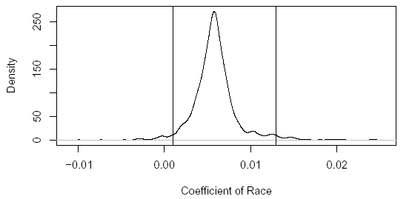
Bootstrap distribution of β₁ with 95% confidence intervals

Slide 48
Study the Association between Number and Payoff
我們為何要研究中獎號碼？
  這個彩卷的發行是否公平？
何謂彩卷的發行是公平的？
  中獎號碼的分配是否接近於一離散均勻分配？
如何檢查中獎號碼的分配是否接近於一離散均勻分配？
  length(lottery.number) #254
  breaks<- 100*(0:10); breaks[1]<- -1
  hist(lottery.number,10,breaks)
  abline(256/10,0) 直條圖看起來相當平坦 (goodnes-of-fit test)
  除非能預測未來，我們挑選的號碼僅有千分之一的機會中獎
這個彩卷的期望獎金為何？
  當每張彩卷以 50 分出售，如果反覆買這個彩卷，我們期望中獎時，其獎金至少為 $500，因為中獎機率為 1/1000。
  boxplot(lottery.payoff, main = "NJ Pick-it Lottery + (5/22/75-3/16/76)", sub = "Payoff")
  lottery.label<- ”NJ Pick-it Lottery (5/22/75-3/16/76)”
  hist(lottery.payoff, main = lottery.label)

Slide 49
Data Analysis
是否中獎獎金曾多次高過 $500 ?
  該如何下注？ 中獎獎金是否含 outliers?
  min(lottery.payoff) # 最低中獎獎金 83
  lottery.number[lottery.payoff == min(lottery.payoff)] # 123
  # <, >, <=, >=, ==, != : 比較指令
  max(lottery.payoff) # 最高中獎獎金 869.5
  lottery.number[lottery.payoff == max(lottery.payoff)] # 499
plot(lottery.number, lottery.payoff); abline(500,0) # 迴歸分析
無母數迴歸分析
  Load “modreg” package.
  a<- loess(lottery.payoff ~ lottery.number,span=50,degree=2)
  a<- rbind(lottery.number[lottery.payoff >= 500],lottery.payoff[lottery.payoff >= 500])
高額中獎獎金的中獎號碼是否具有任何特徵？

Slide 50
高額中獎獎金的中獎號碼特徵
特徵：大部份高額獎金中獎號碼，都有重複的數字。
  此彩卷有一特別下注的方式稱作「combination bets」，下注號碼必須是三個不同的數字，只要下注號碼與中獎號碼中所含的數字相同就算中獎。
  plot(a[1,],a[2,],xlab="lottery.number",ylab="lottery.payoff", main= "Payoff >=500")
  boxplot(split(lottery.payoff,lottery.number%/%100), sub= "Leading Digit of Winning Numbers", ylab= "Payoff")
  依據中獎號碼的首位數字製作盒狀圖。
  當中獎號碼的首位數字為零時，其獎金都較高。一個解釋是較少人會下注這樣的號碼。
在不同時間下，中獎獎金金額的比較。
  qqplot(lottery.payoff, lottery3.payoff); abline(0,1)
  使用盒狀圖來比較不同時間下，中獎獎金金額的分配。
  boxplot(lottery.payoff, lottery2.payoff, lottery3.payoff)
  依時間先後來看，中獎獎金金額漸漸穩定下來，很少能超過 $500。
  rbind(lottery2.number[lottery2.payoff >= 500],lottery2.payoff[lottery2.payoff >= 500])
  rbind(lottery3.number[lottery3.payoff >= 500],lottery3.payoff[lottery3.payoff >= 500])

Slide 51
New Jersey Pick-It Lottery（每天開獎）
三筆數據（收集於不同的時間）：
lottery （254個中獎號碼由1975年5月22日至1976年3月16日）
  number: 中獎號碼由 000 至 999；這個樂透獎自1975年5月22日開始。
  payoff: 中獎號碼所得到的獎金金額；獎金金額為所有中獎者來平分當日下注總金額的半數。
lottery2 (1976年11月10日至1977年9月6日的中獎號碼及獎金) 。
lottery3 (1980年12月1日至1981年9月22日的中獎號碼獎金)。
lottery.number<- scan("c:/lotterynumber.txt")
lottery.payoff<- scan("c:/lotterypayoff.txt")
僅看這一連串的中獎號碼，是頗難看出個所以然。
lottery2<- scan("c:/lottery2.txt")
lottery2<- matrix(lottery2,byrow=F,ncol=2)
lottery2.payoff<- lottery2[,2]; lottery2.number<- lottery2[,1]
lottery3<- matrix(scan("c:/lottery3.txt"),byrow=F,ncol=2)
lottery3.payoff<- lottery3[,2]; lottery3.number<- lottery3[,1]

Slide 52
Old Faithful Geyser in Yellowstone National Park
研究目的：
  便利遊客安排旅遊
  瞭解geyser形成的原因，以便維護環境
數據：
  收集於1985年8月1日至1985年8月15日
  waiting: time interval between the starts of successive eruptions, denote it by wt
  duration: the duration of the subsequent eruption, denote it by dt.
  Some are recorded as L(ong), S(hort) and M(edium) during the night
  w₁ d₁ w₂ d₂
  由 d_{t} 預測 w_{t+1}(迴歸分析)
  In R, use help(faithful) to get more information on this data set.
  Load the data set by data(faithful).
geyser<- matrix(scan("c:/geyser.txt"),byrow=F,ncol=2)
  geyser.waiting<- geyser[,1]; geyser.duration<- geyser[,2]
  hist(geyser.waiting)

Slide 53
Kernel Density Estimation
The function `density' computes kernel density estimates with the given kernel and bandwidth.
  density(x, bw = "nrd0", adjust = 1, kernel = c("gaussian", "epanechnikov", "rectangular", "triangular", "biweight", "cosine", "optcosine"), window = kernel, width, give.Rkern = FALSE, n = 512, from, to, cut = 3, na.rm = FALSE)
  n: the number of equally spaced points at which the density is to be estimated.
hist(geyser.waiting,freq=FALSE)
  lines(density(geyser.waiting))
  plot(density(geyser.waiting))
  lines(density(geyser.waiting,bw=10))
  lines(density(geyser.waiting,bw=1,kernel=“e”))
Show the kernels in the R parametrization
  (kernels <- eval(formals(density)$kernel))
  plot (density(0, bw = 1), xlab = "", main="R's density() kernels with bw = 1")
  for(i in 2:length(kernels)) lines(density(0, bw = 1, kern = kernels[i]), col = i)
  legend(1.5,.4, legend = kernels, col = seq(kernels), lty = 1, cex = .8, y.int = 1)

Slide 54
The Effect of Choice of Kernels
The average amount of annual precipitation (rainfall) in inches for each of 70 United States (and Puerto Rico) cities.
data(precip)
bw <- bw.SJ(precip) ## sensible automatic choice
plot(density(precip, bw = bw, n = 2^13), main = "same sd bandwidths, 7 different kernels")
for(i in 2:length(kernels)) lines(density(precip, bw = bw, kern = kernels[i], n = 2^13), col = i)

Slide 55
迴歸分析
duration<- geyser.duration[1:298]
waiting<- geyser.waiting[2:299]
plot(duration,waiting,xlab="噴泉持續時間",ylab="waiting")
plot(density(duration),xlab="噴泉持續時間",ylab="density") plot(density(geyser.waiting),xlab="waiting",ylab="density")
# 由 w_{t} 預測 d_{t}
plot(geyser.waiting,geyser.duration,xlab="waiting", ylab="duration")
可能之物理模型
噴泉口之下方有一細長tube，內充滿了水而受環繞岩石加熱。
由於tube內滿了大量的水，故tube下方的水因壓力的緣故，其沸點較高，且愈深處沸點愈高。
當tube上方的水，因環繞岩石加熱達到沸點變為蒸氣；而較下方的水因壓力降低，故其沸點隨之降低，而加速將下方的水變為蒸氣，故開始噴泉。
有關此物理模型之進一步討論，參看Rinehart (1969; J. Geophy. Res., 566-573)
依據上述理論，可期待此次噴泉duration較長久者，等待噴泉口再次噴泉之時間可能較長。

Slide 56
迴歸分析
分析一:由 d_{t} 預測 w_{t+1}
  plot(duration,waiting,xlab=“噴泉持續時間”, ylab=“waiting")
分析二:期待duration的時間長短交錯，探討時間與 d_{t} 之關係(時間序列
分析A
  ts.plot(geyser.duration,xlab=“時間”,ylab=“噴泉持續時間”)
  此時間序列呈現高度振盪，且振盪於兩個水準之間
分析B: d_{t+1} versus d
  lag.plot(geyser.duration,1)
  問題 1: 噴泉時間短者，其隨後噴泉時間較長，但噴泉時間長者，其隨後噴泉時間大多較短
  改良物理模型；嘗試較複雜之Second-Order Markov Chain

Slide 57
Explore Association
Data(stackloss)
  It is a data frame with 21 observations on 4 variables.
  [,1] `Air Flow' Flow of cooling air
  [,2] `Water Temp' Cooling Water Inlet Temperature
  [,3] `Acid Conc.' Concentration of acid [per 1000, minus 500]
  [,4] `stack.loss' Stack loss
  The data sets `stack.x', a matrix with the first three (independent) variables of the data frame, and `stack.loss', the numeric vector giving the fourth (dependent) variable, are provided as well.
Scatterplots, scatterplot matrix:
  plot(stackloss$Ai,stackloss$W)
  plot(stackloss) data(stackloss)
  two quantitative variables.
summary(lm.stack <- lm(stack.loss ~ stack.x))
summary(lm.stack <- lm(stack.loss ~ stack.x))

Slide 58
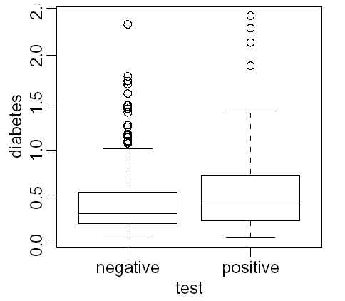
Explore Association
Boxplot suitable for showing a quantitative and a qualitative variable.
The variable test is not quantitative but categorical.
  Such variables are also called factors.

Slide 59

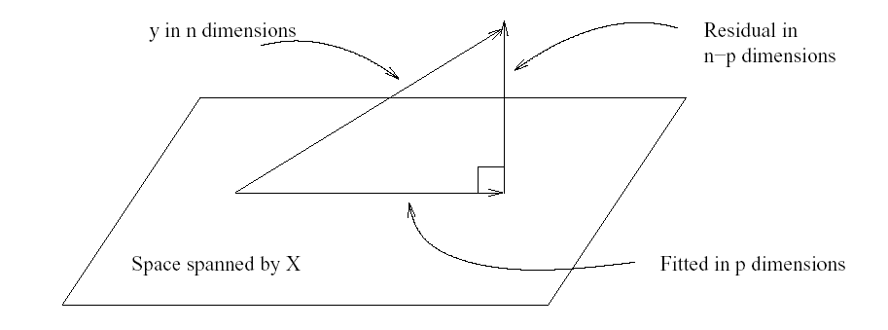
LEAST SQUARES ESTIMATION
Geometric representation of the estimation β.
  The data vector Y is projected orthogonally onto the model space spanned by X.
  The fit is represented by projection with the difference between the fit and the data represented by the residual vector e.

Slide 60
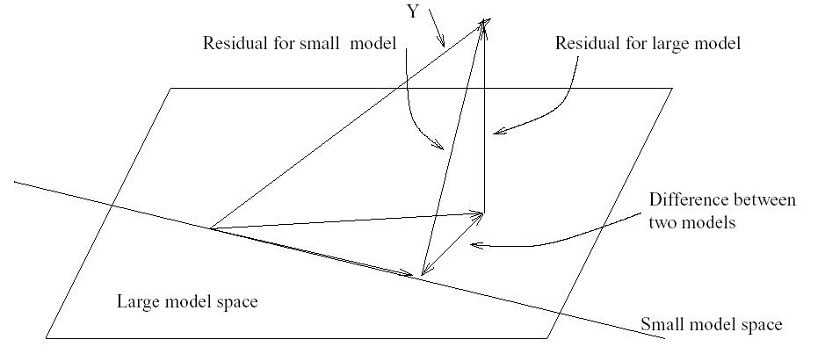
Hypothesis tests to compare models
Given several predictors for a response, we might wonder whether all are needed.
  Consider a large model, Ω, and a smaller model, ω, which consists of a subset of the predictors that are in Ω.
  By the principle of Occam’s Razor (also known as the law of parsimony), we’d prefer to use ω if the data will support it.
  So we’ll take ω to represent the null hypothesis and Ω to represent the alternative.
  A geometric view of the problem may be seen in the following figure.

